Slide 1
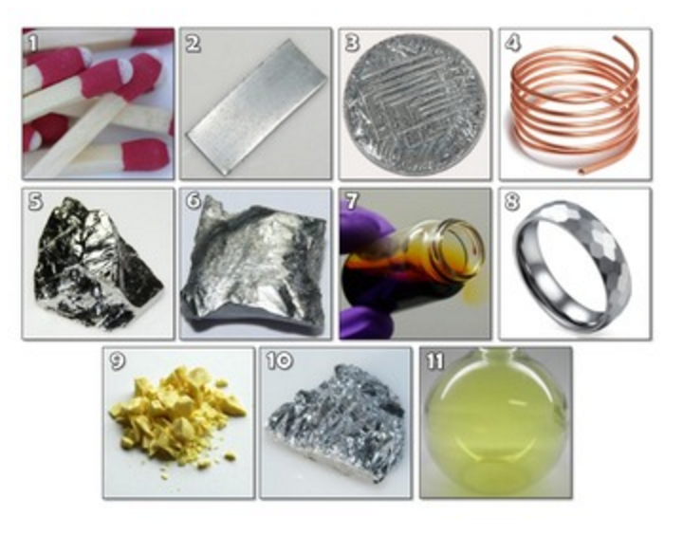

Slide 2
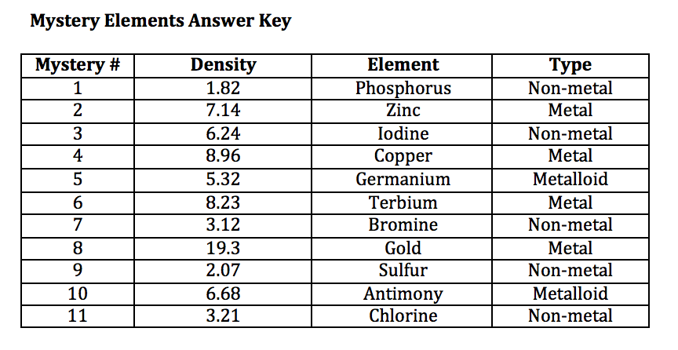

Slide 3
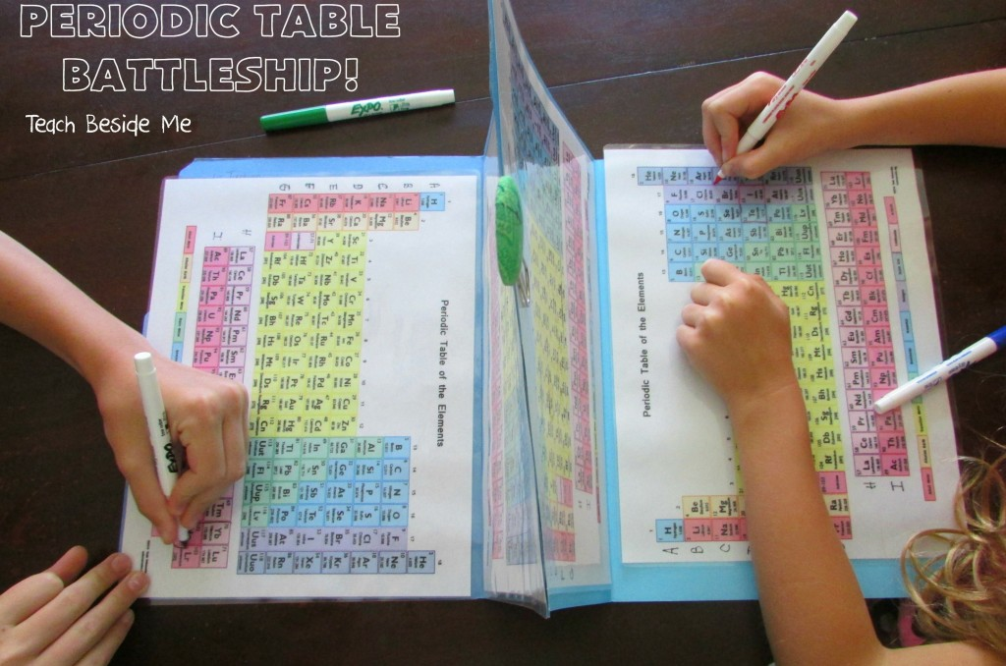

Slide 4
To play the game, each player should use their dry erase marker to circle a series of elements on the bottom periodic table—this is the game board.
Students should circle 5 “ships” of different element lengths on their board.
- “Ships” cannot go diagonally across the periodic table; they must be vertical or horizontal.
b. Ships should be the following lengths:
• 2 elements
• 3 elements
• 2 that are 4 elements
• 5 elements
c. Once “ships” are selected, players take turns asking their opponent possible positions for their “ships.” Players should ask in the form of Period #, Group # or by asking for atomic symbol.
d. Players should mark off when they hit or miss their opponent’s “ships” on the top periodic table. Players can choose their own marks for hit or miss.
e. If a player’s “ship” is hit, the player should write an X over the element that the opponent has called.
6. The game is over when a player has sunk all of the opponent’s “ships.”

